Slide 1
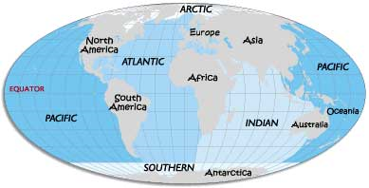
Oceans
9/24/2009

Slide 2
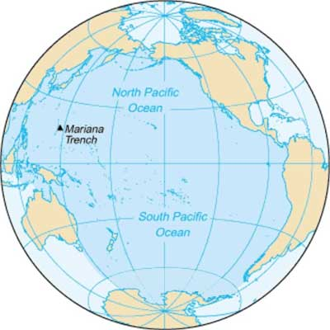
Pacific Ocean
Largest ocean
Covers more space than all of the continents put together
Majority of the water is warm
Largest and deepest ocean

Slide 3
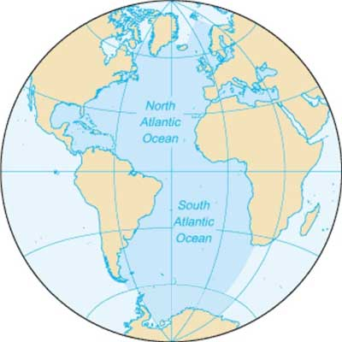
Atlantic Ocean
As long as the Pacific, but only half the width
Second largest ocean
Second deepest ocean
Ocean that borders Florida!

Slide 4
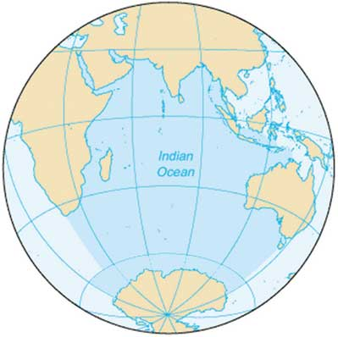
Indian Ocean
Lies between Africa and Australia
90% of the water is south of the equator
Third largest ocean
Third deepest ocean

Slide 5
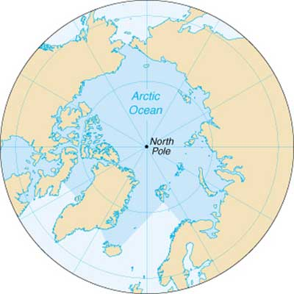
Arctic Ocean
Smallest ocean
Most shallow ocean
One of the coldest oceans
Majority of its water is frozen

Slide 6
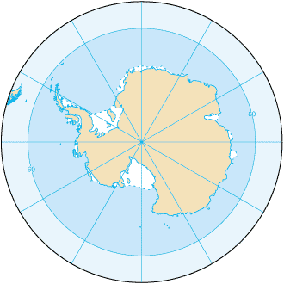
Southern Ocean
Also called the Antarctic Ocean
The coldest ocean
Encircles all of Antarctica
Newest ocean
Created in 2000

